Slide 1
Ubuntu 22.04 / QGroundControl – Development Guide
작성: 정도윤
2022-11-04

Slide 2
목차
1. 우분투 22.04 설치
2. Git 설치
3. Qt5 설치
4. QGroundControl with Ubuntu 22.04 개발환경 구축
5. QGroundControl with Ubuntu 22.04 개발환경에서 실행
6. QGroundControl with Ubuntu 22.04 개발환경에서 실행(비행 경로 계획)
7. 우분투 22.04 / 개발 환경

Slide 3
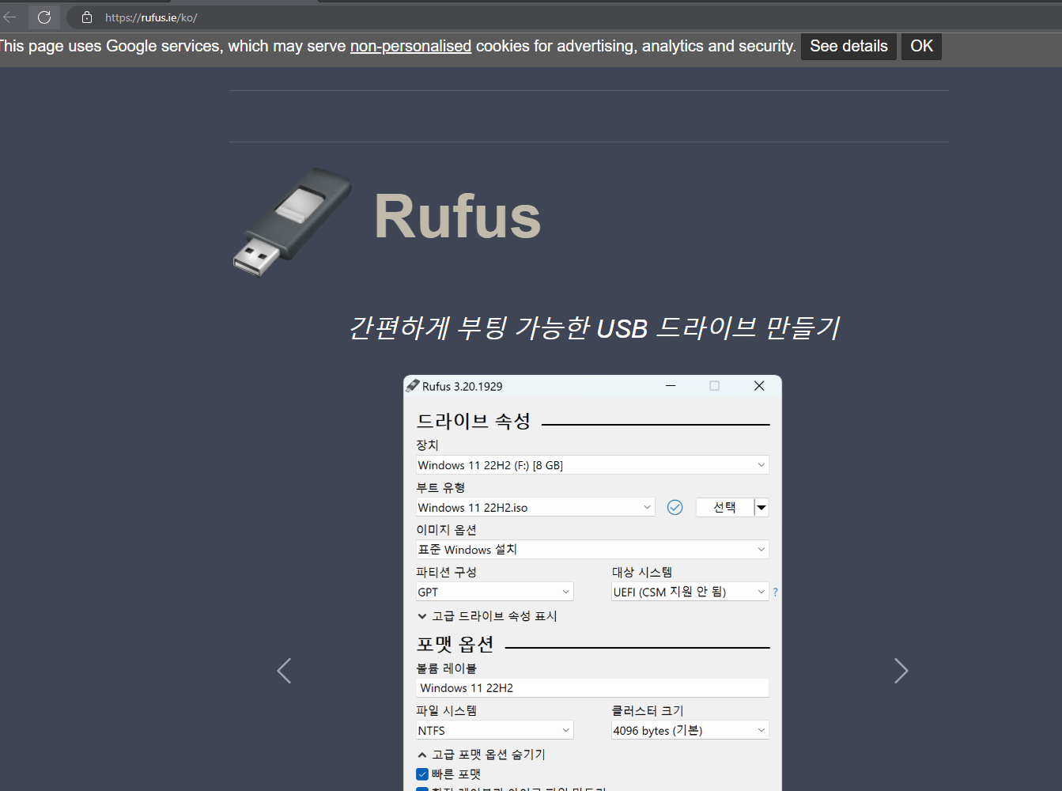
1. 우분투 22.04 설치
https://rufus.ie/ko
Last Modified 2022-11-05, Accessed by 2022-11-05.

Slide 4
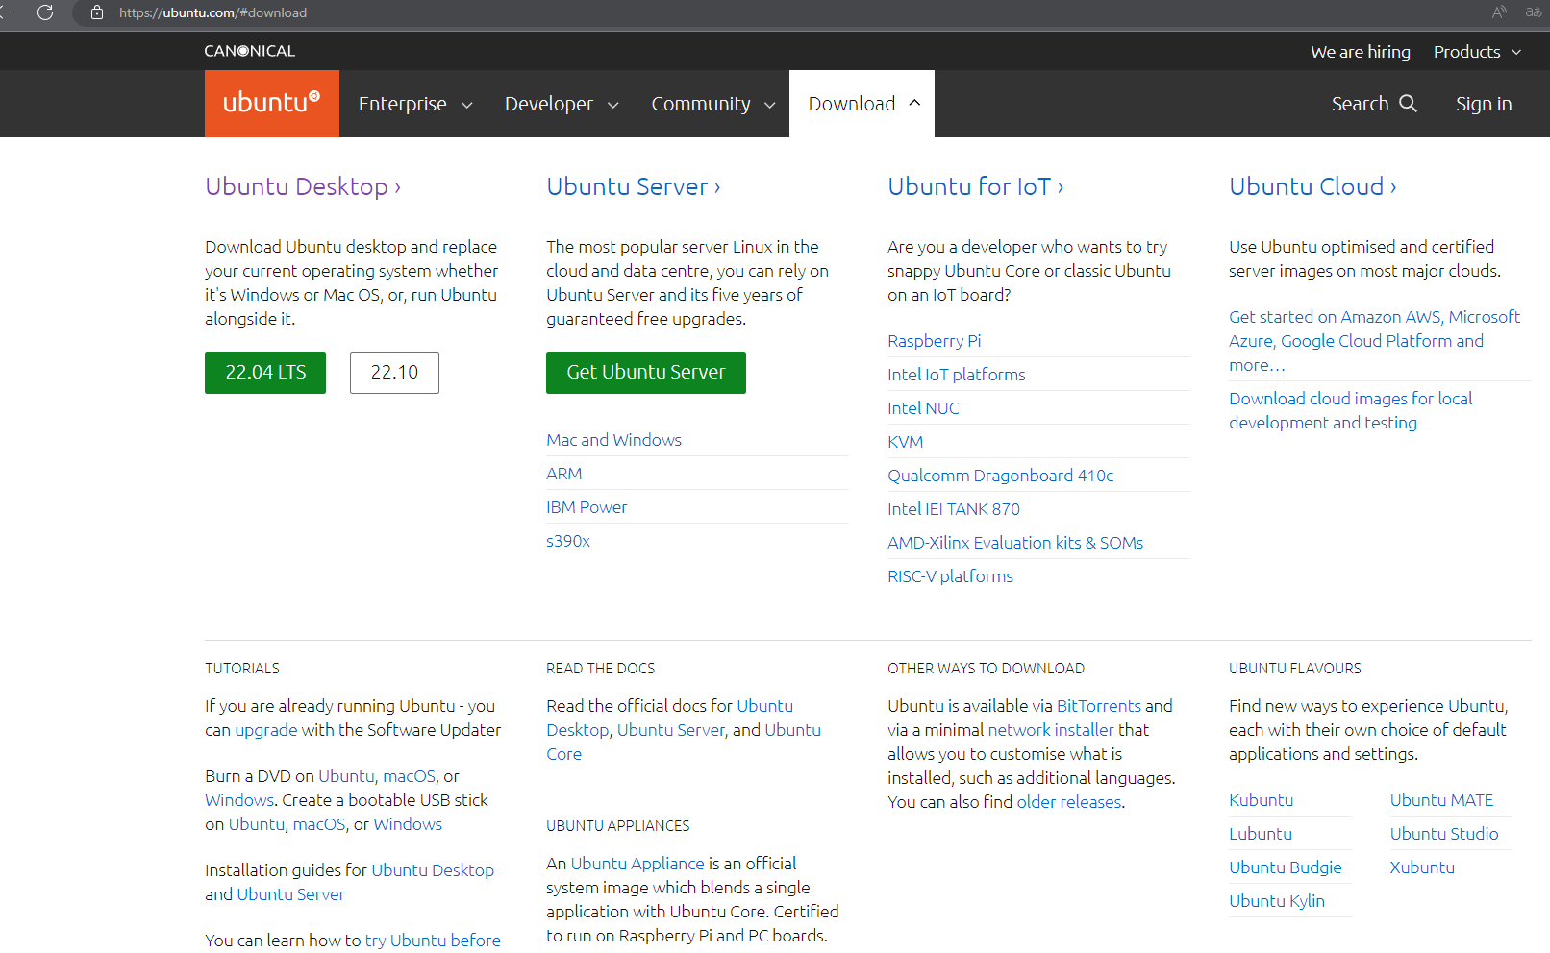
1. 우분투 22.04 설치
https://ubuntu.com
Last Modified 2022-11-05, Accessed by 2022-11-05.

Slide 5
2. Git 설치
/*
Created Date: 2022-11-05
Author: Doyoon Jung(정도윤) / rabbit.white@daum.net
Subject: Git Install Guide with Ubuntu 22.04
Description:
*/
Step 1. Update the system
# sudo apt-get update
# sudo apt-get upgrade -y
Step 2. Install git
# sudo apt install git
Step 3. Verify Installation
# git --version

Slide 6
3. Qt5 설치
/*
Created Date: 2022-11-05
Author: Doyoon Jung(정도윤) / rabbit.white@daum.net
Subject: Qt5 Install Guide with Ubuntu 22.04
Description:
*/
1. 필수 개발환경 설치
# sudo apt-get update
# sudo apt-get install build-essential
2. QT Creator (IDE)
# sudo apt-get install qtcreator
3. Install Package
sudo apt install -y qtcreator qtbase5-dev qt5-qmake cmake
4. Qt5 install problem Ubuntu 22.04 Solution
오피셜 사이트 접속할 것: https://qt.io
sudo chmod +x qt-opensource-linux-x64-5.12.10.run
(설치 용량: 약 16GB 이상 소요)
(이메일 계정: 인증 필수)

Slide 7
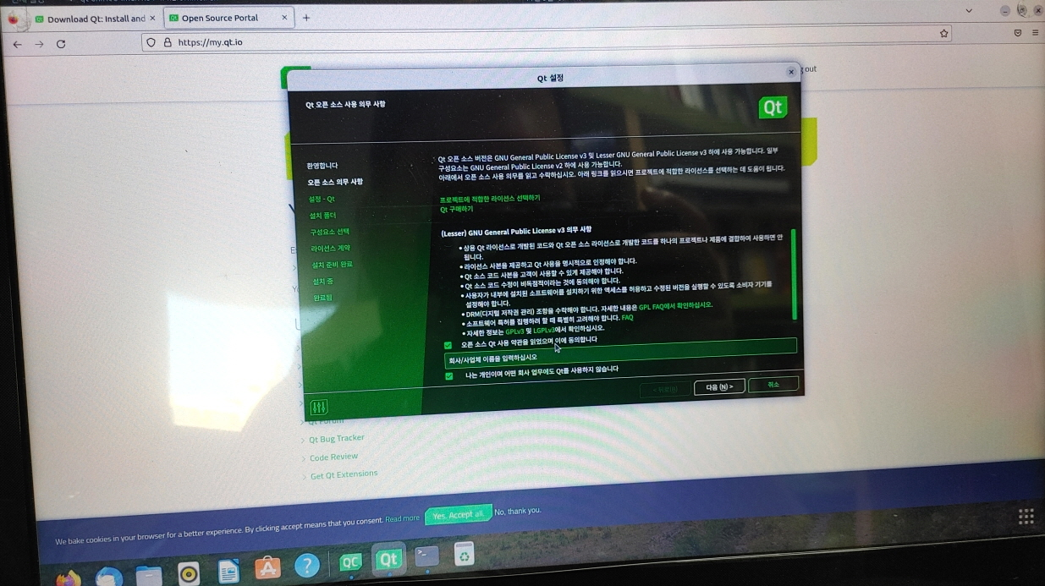
3. Qt5 설치

Slide 8
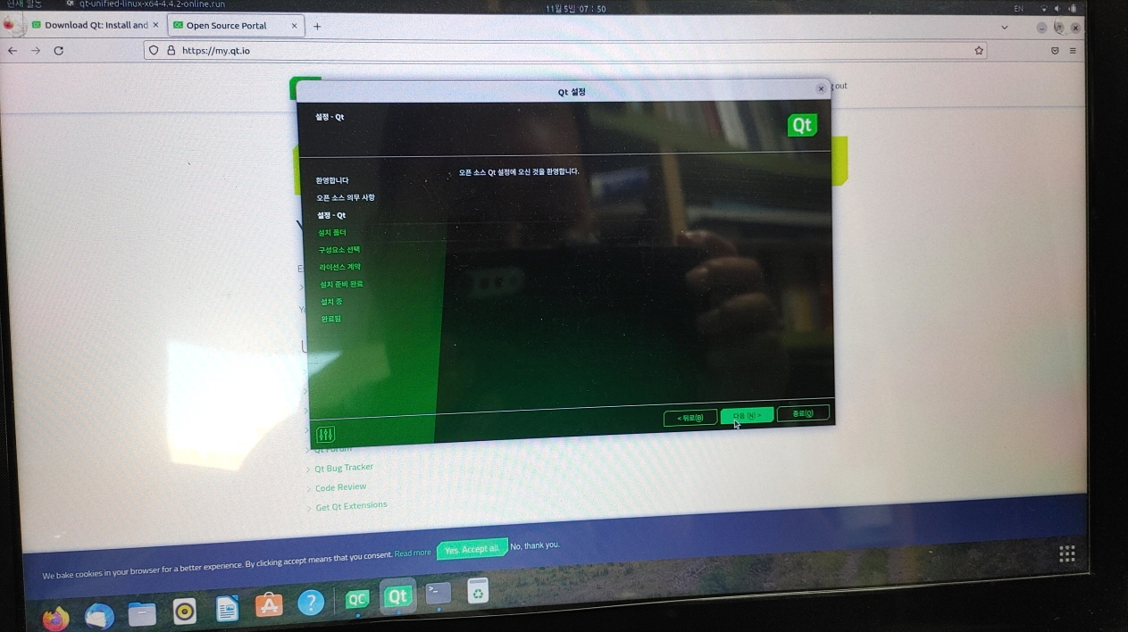
3. Qt5 설치

Slide 9
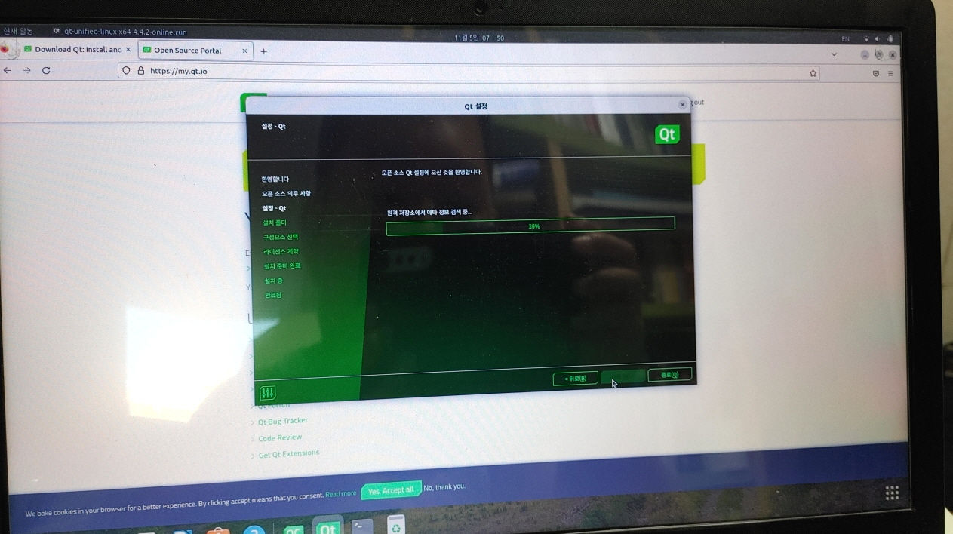
3. Qt5 설치

Slide 10
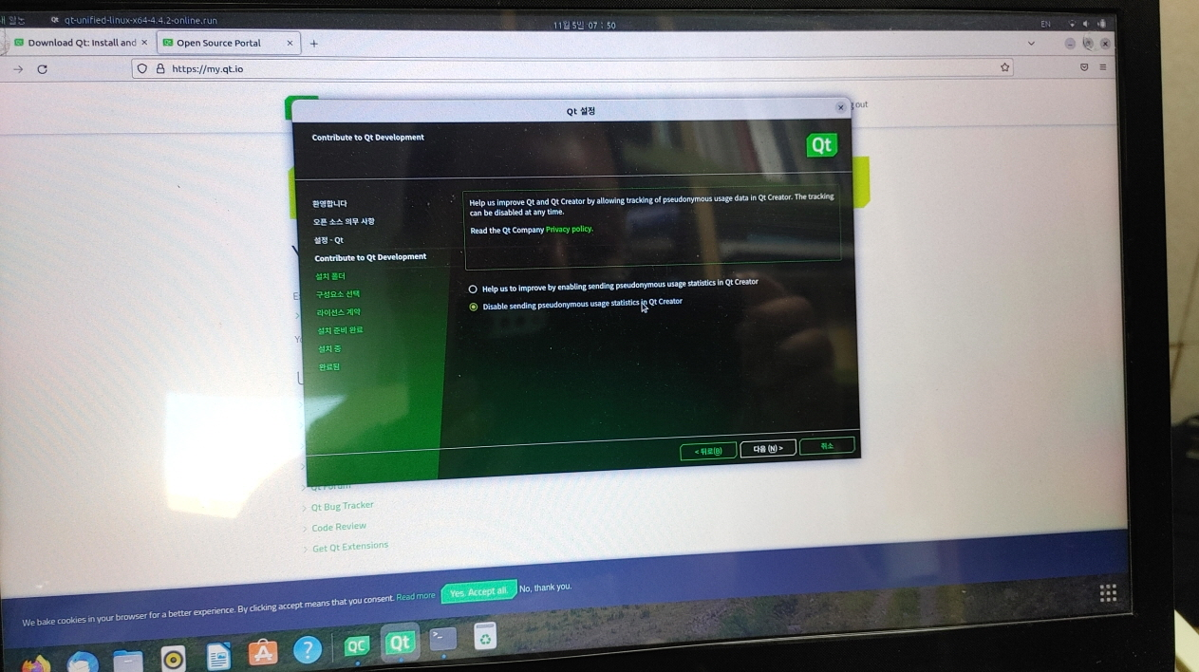
3. Qt5 설치

Slide 11
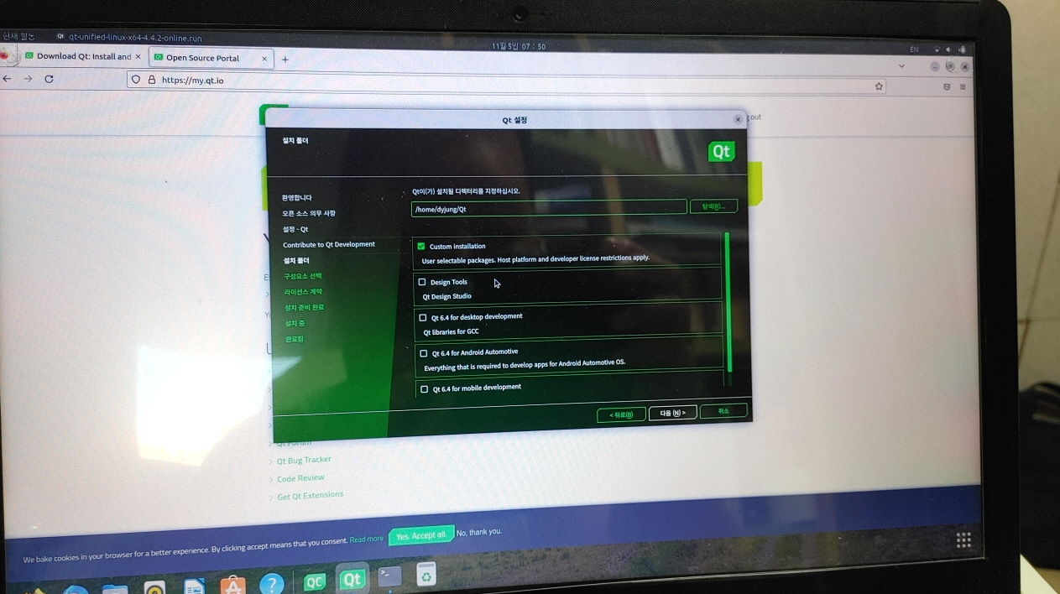
3. Qt5 설치

Slide 12
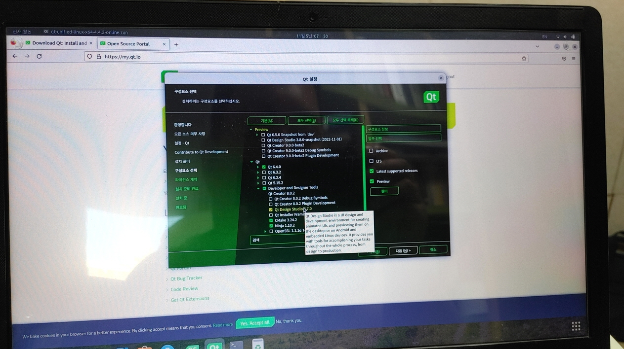
3. Qt5 설치

Slide 13
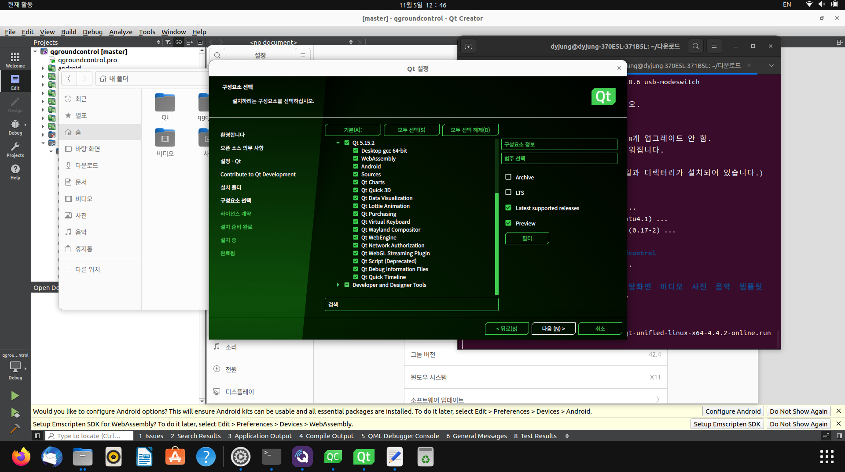
3. Qt5 설치

Slide 14
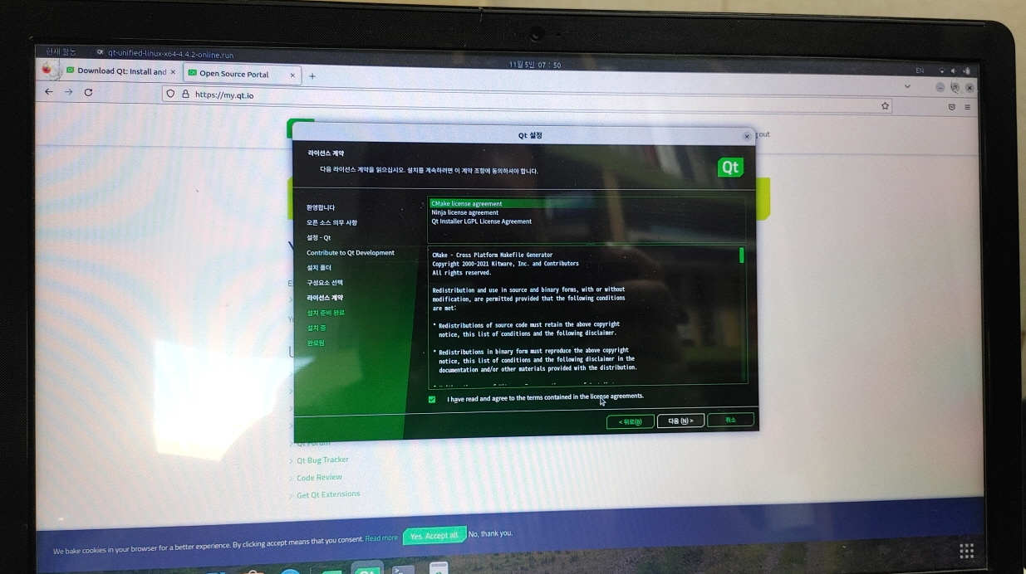
3. Qt5 설치

Slide 15
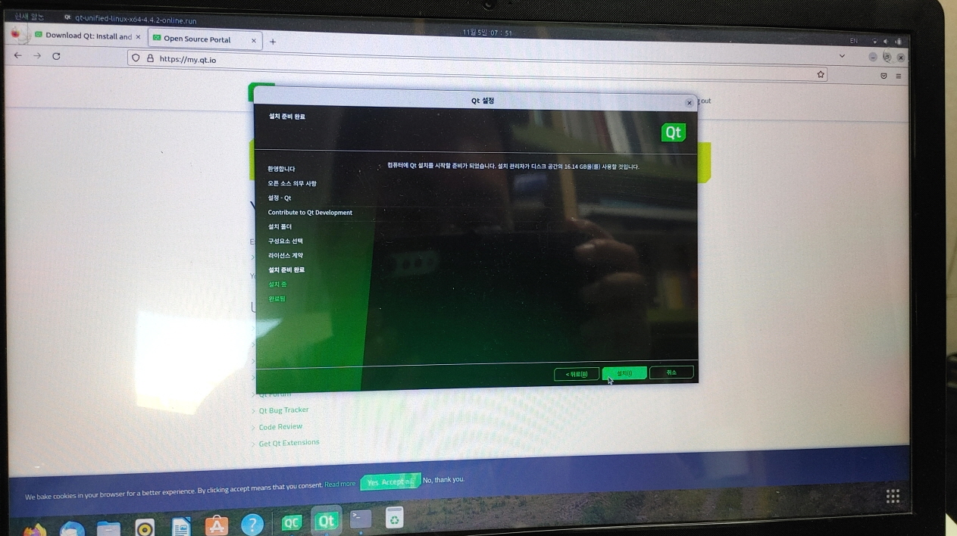
3. Qt5 설치

Slide 16
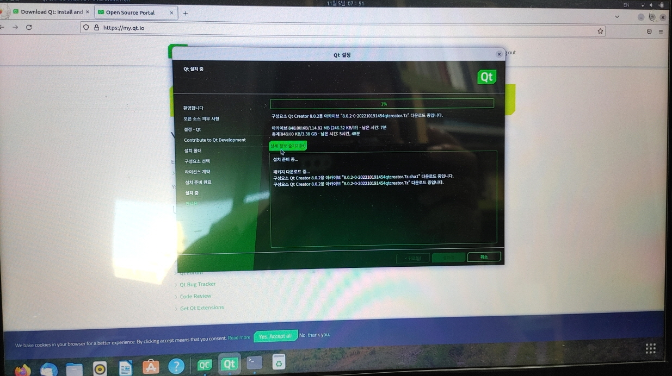
3. Qt5 설치

Slide 17
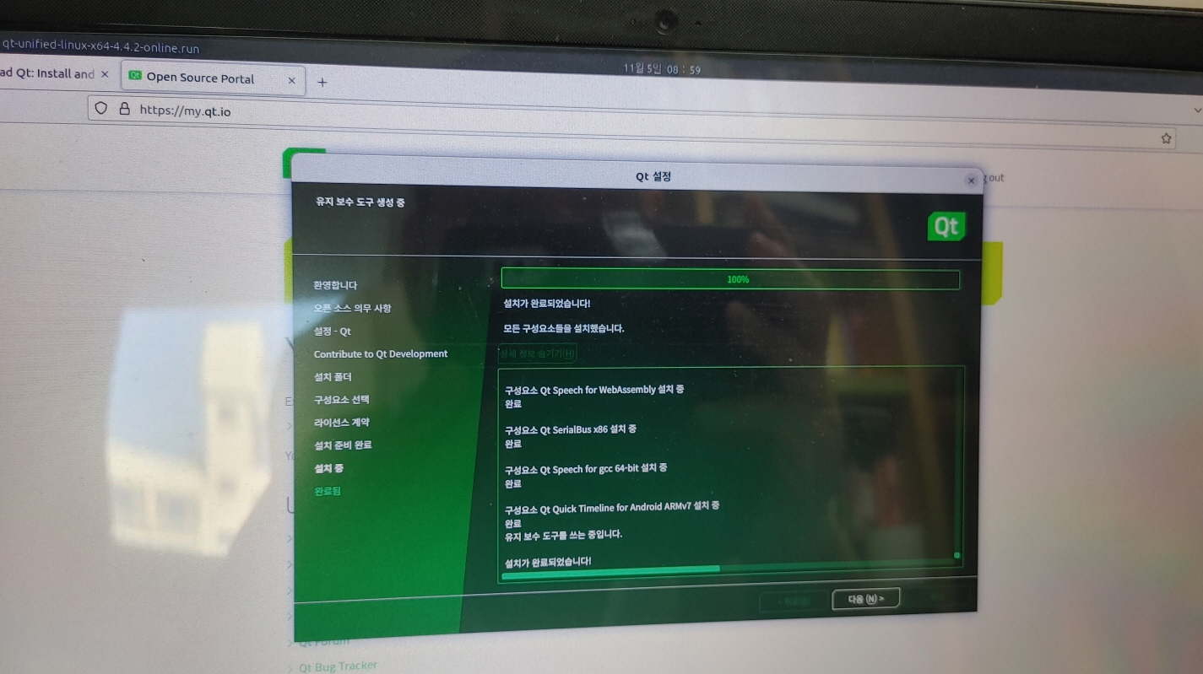
3. Qt5 설치

Slide 18
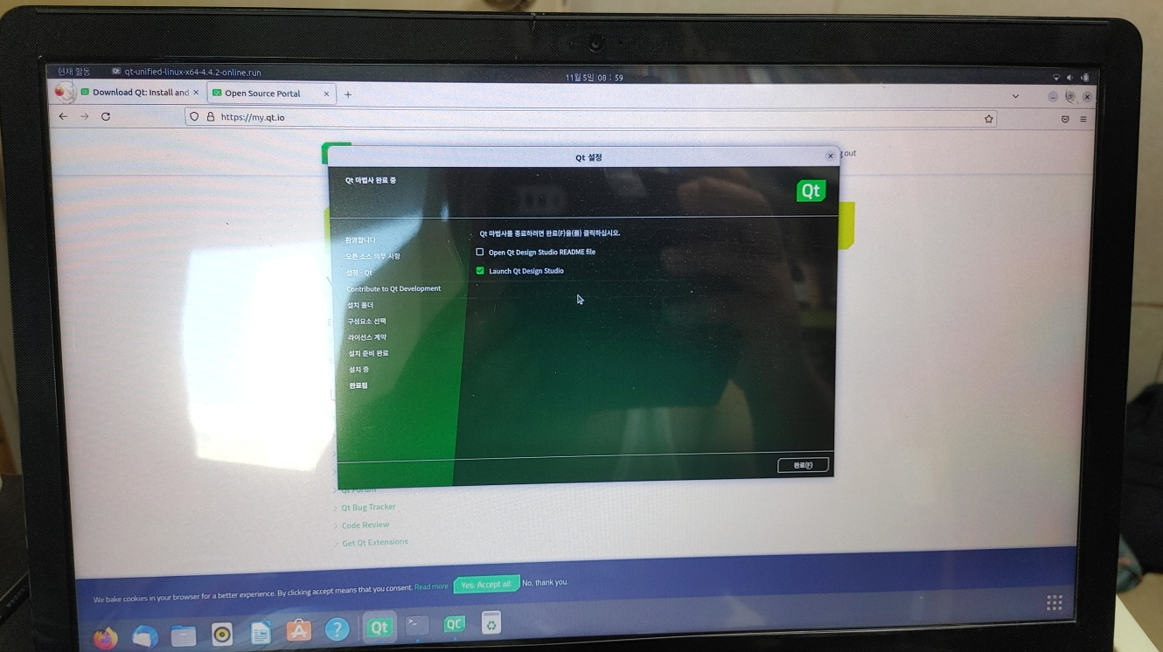
3. Qt5 설치

Slide 19
3. Qt5 설치
5. QT 종속파일 생성
sudo apt install libfontconfig1 build-essential mesa-common-dev libglu1-mesa-dev
6. 바탕화면 아이콘 생성
touch ~/.local/share/applications/Qt-Creator.desktop
echo "[Desktop Entry] Version=1.0 Encoding=UTF-8 Type=Application Name=QtCreator Comment=QtCreator NoDsiplay=true Exec=(Install folder of QT)/Tools/QtCreator/bin/qtcreator %f Icon=(Install folder of QT)/5.4/Src/qtdoc/doc/images/landing/icon_QtCreator_78x78px.png Name[en_US]=Qt-Creator" > ~/.local/share/applicationsQt-Creator.desktop
7. Update the permissions of the Qt Creator file with chmod.
sudo chmod +x ~/.local/share/applicationsQt-Creator.desktop
8. Make Qt the default file association for pro files on Ubuntu using echo.
echo "text/qtcreator=Qt-Creator.desktop;" >> ~/.local/share/applications/defaults.list
After adding the file association, everything should work.

Slide 20
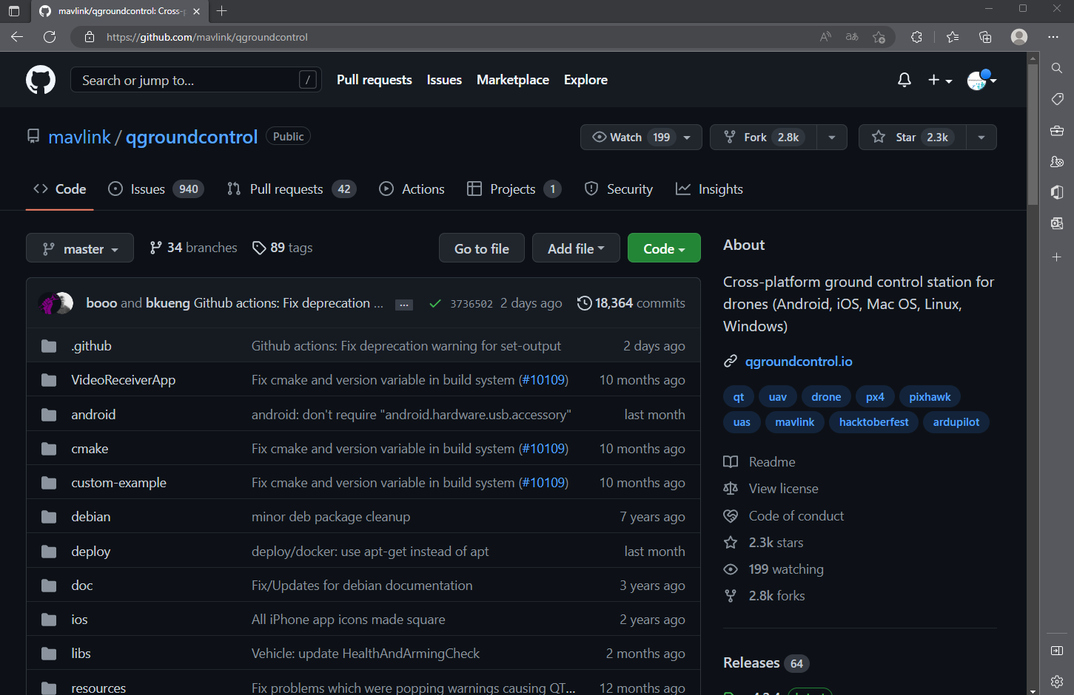
4. QGroundControl with Ubuntu 22.04 개발환경 구축
https://github.com/mavlink/qgroundcontrol
Last Modified 2022-11-05, Accessed by 2022-11-05.

Slide 21
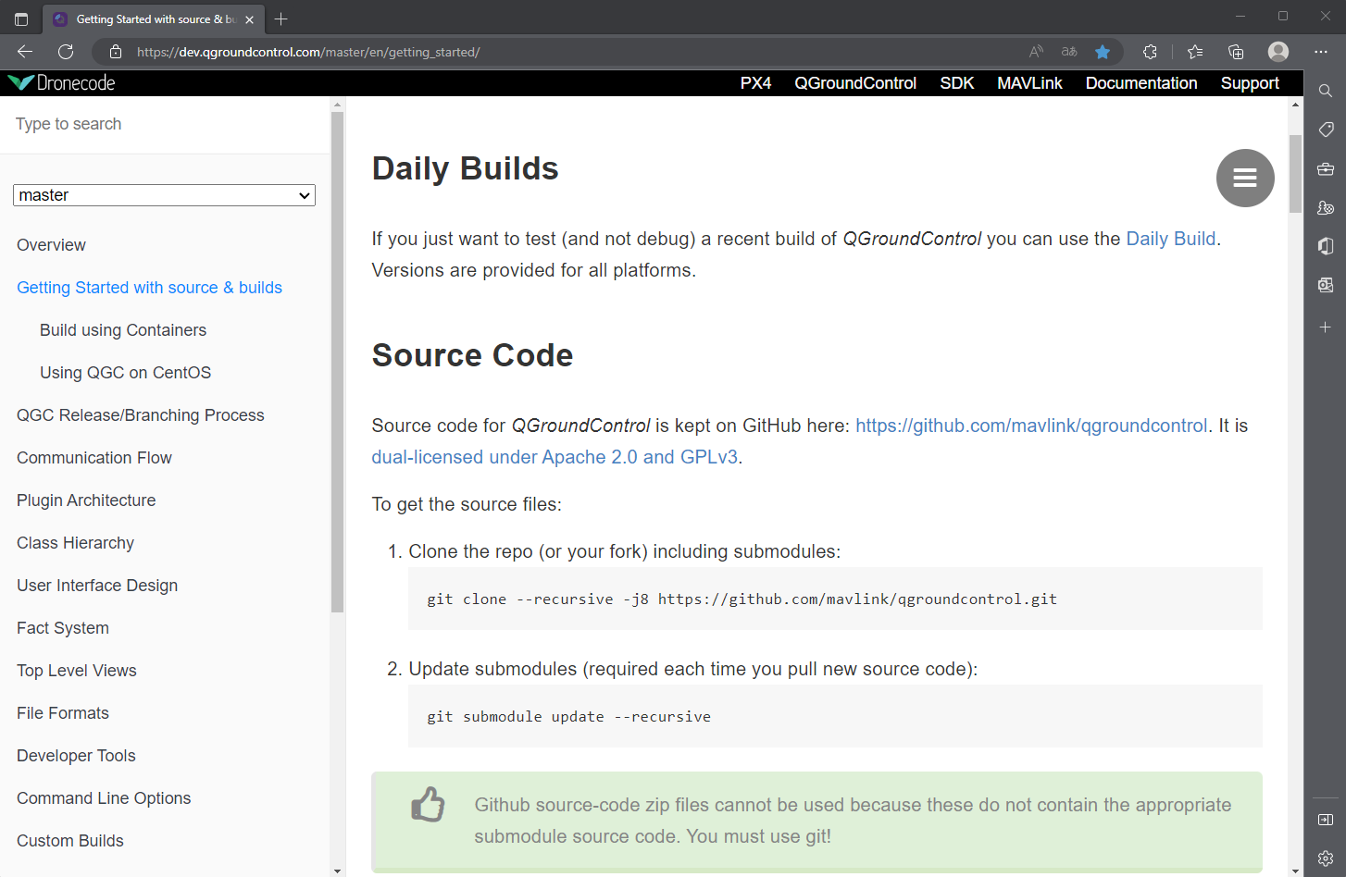
4. QGroundControl with Ubuntu 22.04 개발환경 구축
https://dev.qgroundcontrol.com/master/en/getting_started/
Last Modified 2022-11-05, Accessed by 2022-11-05.

Slide 22
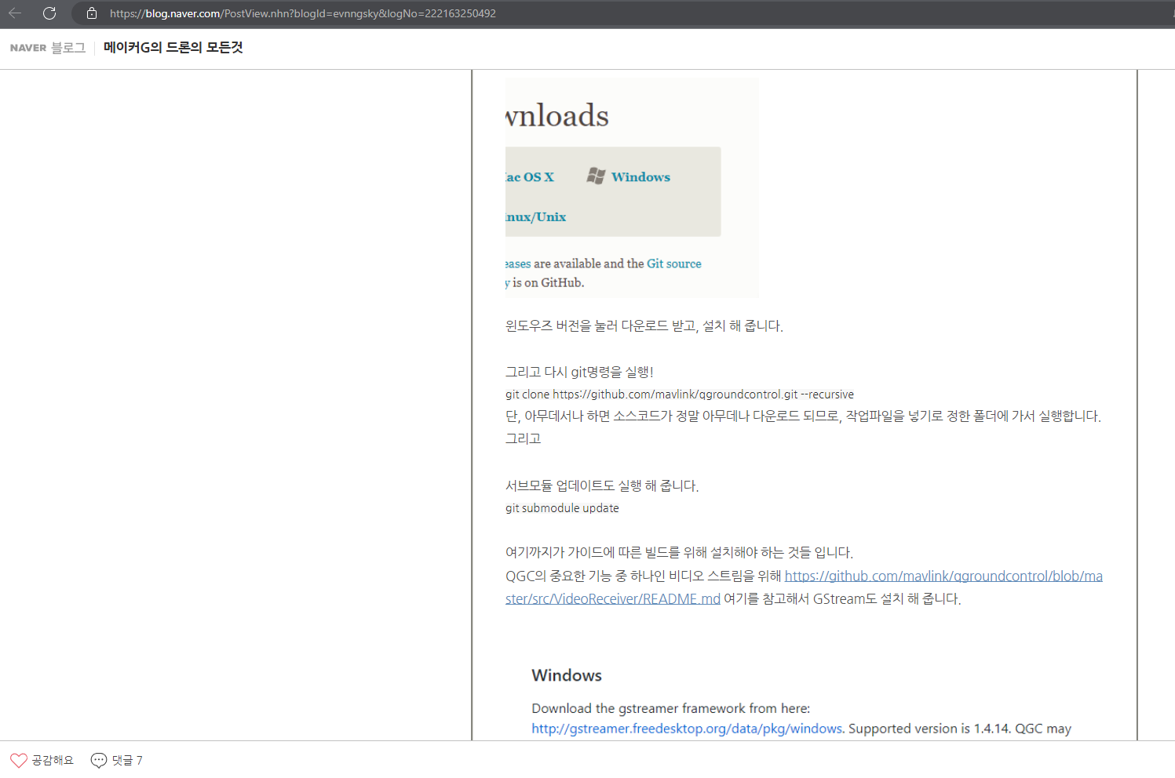
4. QGroundControl with Ubuntu 22.04 개발환경 구축
Last Modified 2022-11-05, Accessed by 2022-11-05.
https://blog.naver.com/PostView.nhn?blogId=evnngsky&logNo=222163250492

Slide 23
4. QGroundControl with Ubuntu 22.04 개발환경 구축
/*
Created Date: 2022-11-05
Author: Doyoon Jung(정도윤) / rabbit.white@daum.net
Subject: QGroundControl with Ubuntu 22.04
Description:
*/
Step 1. Git clone
# git clone https://github.com/mavlink/qgroundcontrol.git --recursive
Step 2. Submodule Update
# git submodule update --init --recursive
Step 3. GStreamer
Linux
Use apt-get to install GStreamer 1.0
# list=$(apt-cache --names-only search ^gstreamer1.0-* | awk '{ print $1 }' | sed -e /-doc/d | grep -v gstreamer1.0-hybris)
# sudo apt-get install $list
# sudo apt-get install libgstreamer-plugins-base1.0-dev
# sudo apt-get install libgstreamer-plugins-bad1.0-dev
The build system is setup to use pkgconfig and it will find the necessary headers and libraries automatically.
Step 4. Projects
-> Desktop Qt 5.15.2 GCC로 설정할 것
-> Clean Steps
Override /usr/bin/make: /usr/bin/make로 입력할 것
Step 5. Missing header files ("airmap/client.h no such file or directory")
# sudo apt-get install -y build-essential curl
# curl --location --output "$${AIRMAP_PLATFORM_SDK_FILEPATH}" "$${AIRMAP_PLATFORM_SDK_URL}"

Slide 24
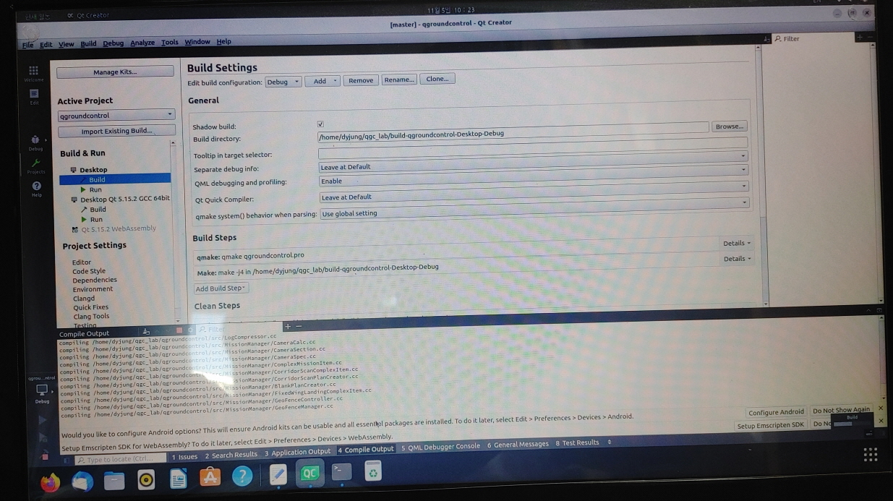
4. QGroundControl with Ubuntu 22.04 개발환경 구축

Slide 25
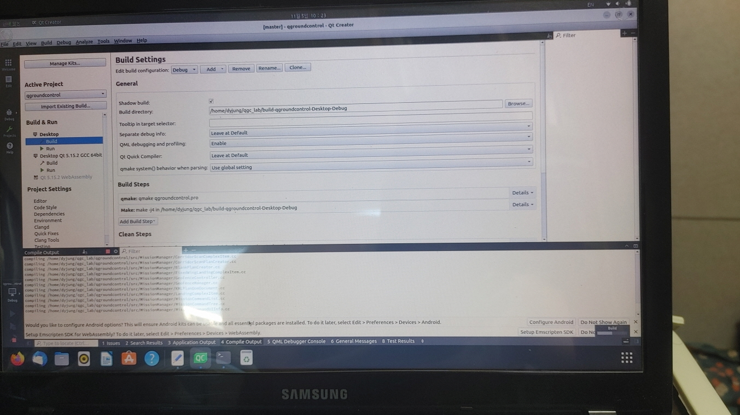
4. QGroundControl with Ubuntu 22.04 개발환경 구축

Slide 26
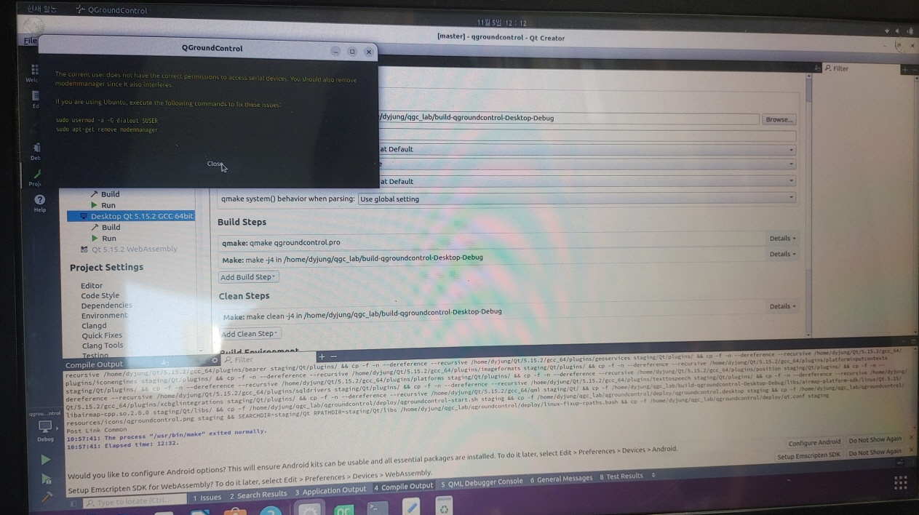
4. QGroundControl with Ubuntu 22.04 개발환경 구축

Slide 27
4. QGroundControl with Ubuntu 22.04 개발환경 구축
Step 6. fixed issue
# sudo usermod -a -G dialout $USER
# sudo apt-get remove modemmanager

Slide 28
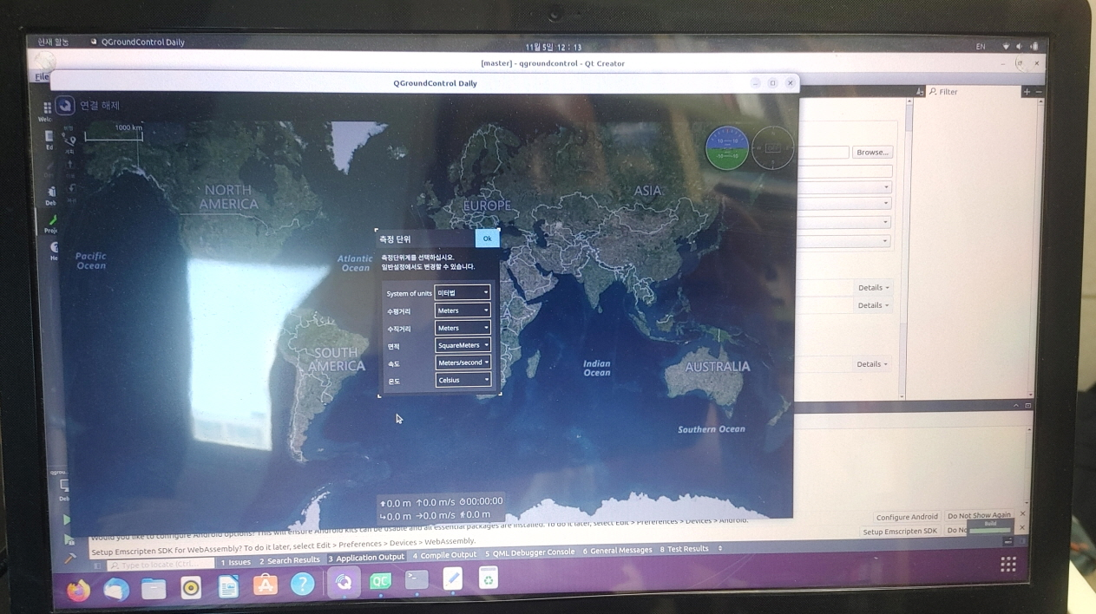
5. QGroundControl with Ubuntu 22.04 개발환경에서 실행

Slide 29
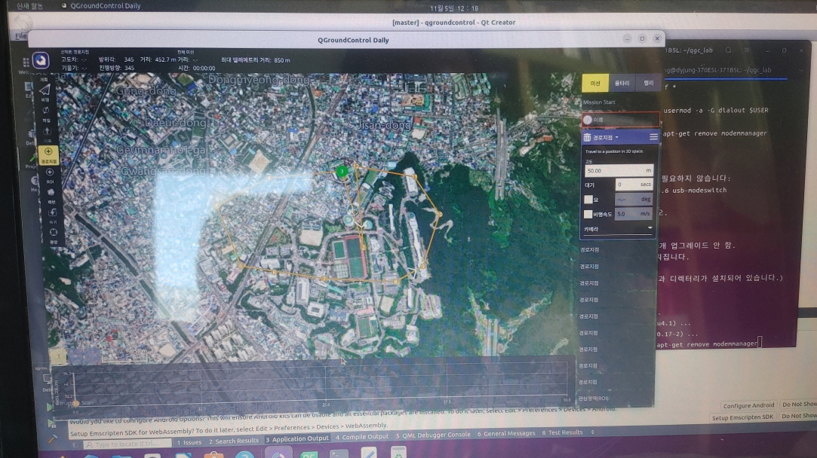
5. QGroundControl with Ubuntu 22.04 개발환경에서 실행

Slide 30
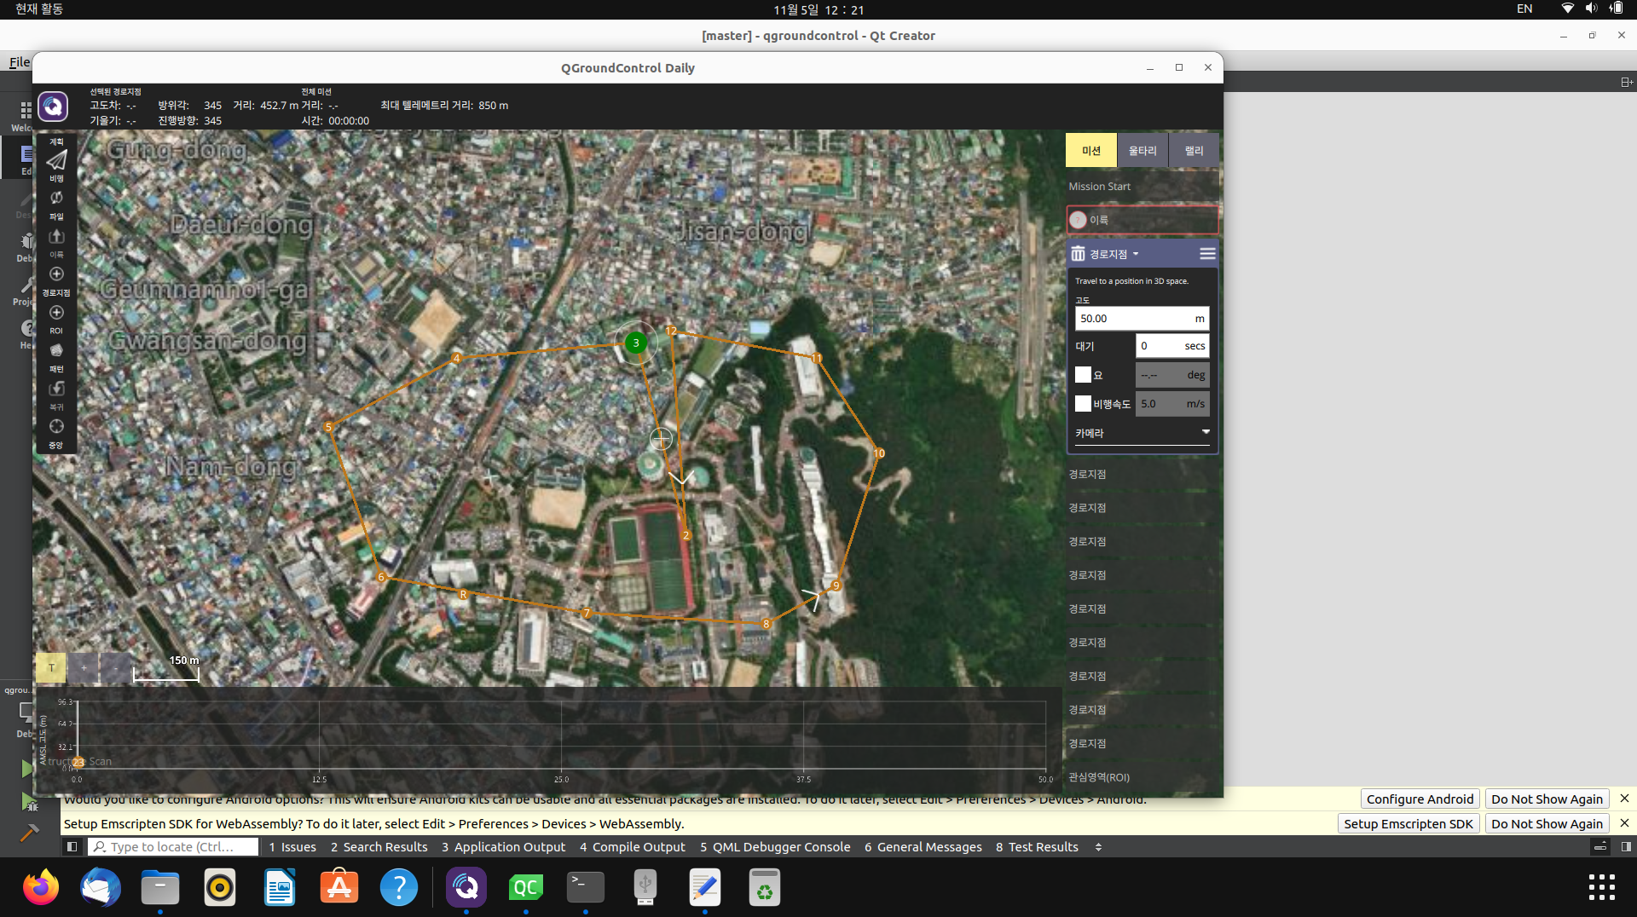
5. QGroundControl with Ubuntu 22.04 개발환경에서 실행

Slide 31
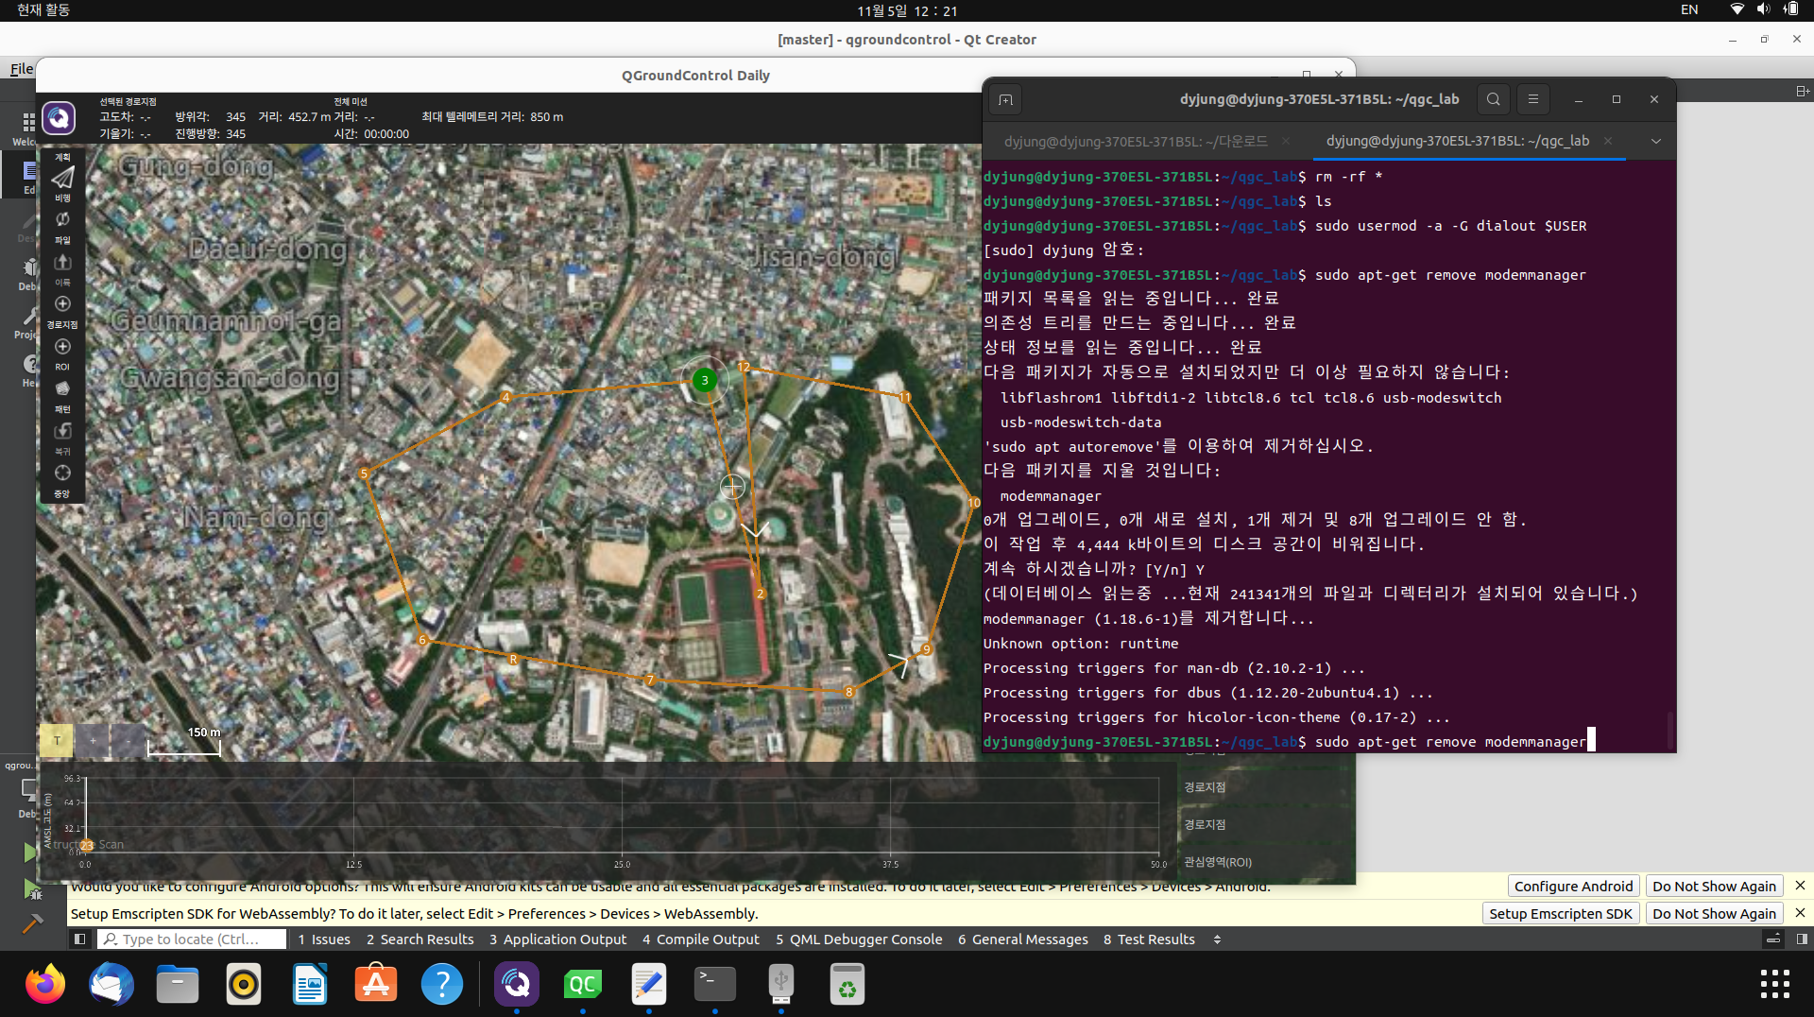
6. QGroundControl with Ubuntu 22.04 개발환경에서 실행(비행 경로 계획)

Slide 32
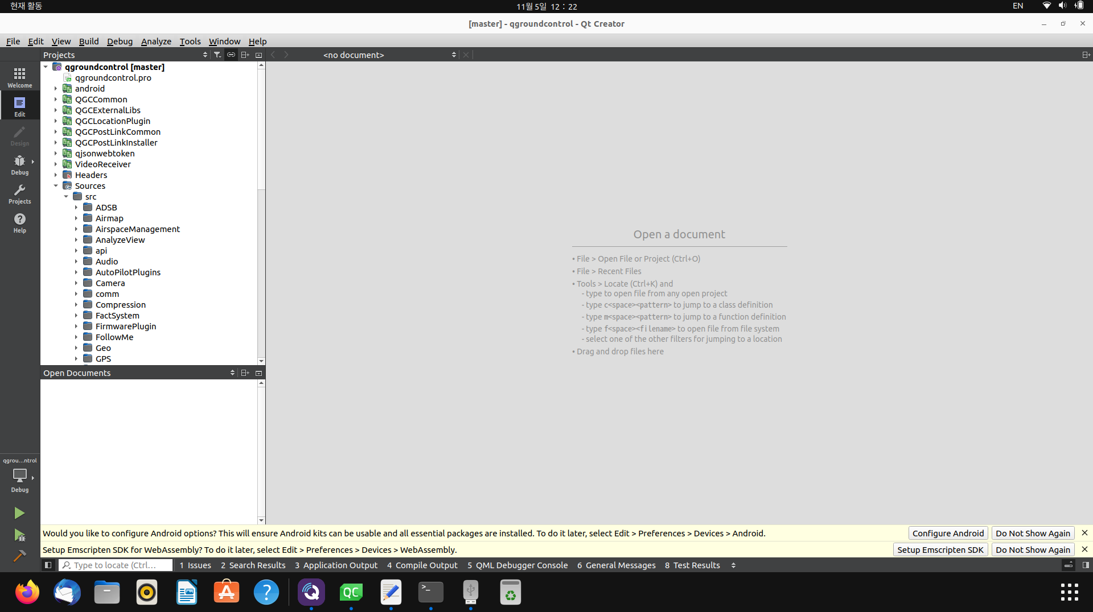
5. QGroundControl with Ubuntu 22.04 개발환경에서 실행

Slide 33
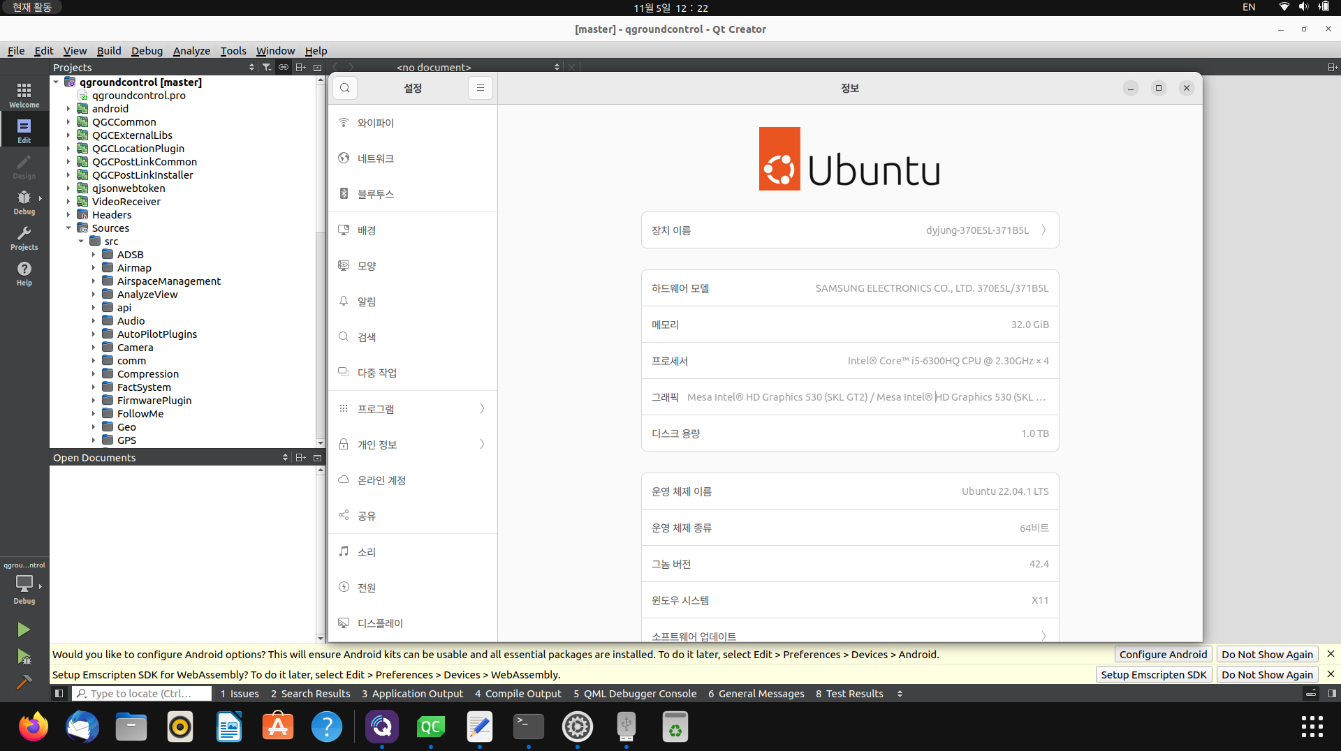
7. 우분투 22.04 / 개발 환경
NT-371B5L
DDR4 32GB
Intel HD Graphics 530 / Nvidia Geforce 920MX
1) SSD 512GB +
2) M.2 SSD 512GB

Slide 34
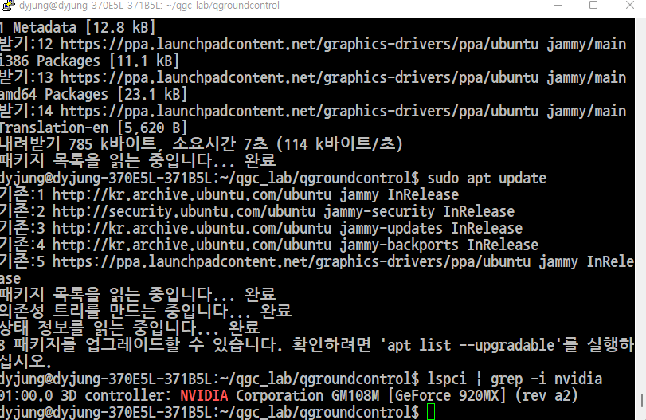
7. 우분투 22.04 / 개발 환경

